Slide 1
Healthcare people:
Medical Device Technology

Slide 2
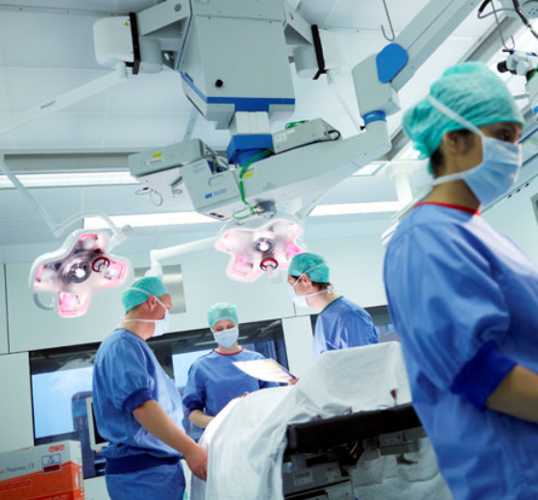
THE MEDICAL DEVICE INDUSTRY
DEPENDS UPON PRECISION
Parts and equipment must perform to perfection. Distribution of these devices should also be on time and accurate.
Fierce competition within the medical device sector has caused many companies to use delivery as their competitive advantage, such as next day.
Hospitals have unique complex infrastructures that presents a challenge to most transport providers. Local knowledge is essential.
Medical device manufacturers pay to keep high consignment stock to maintain product availability for sales and keep up with hospital demand.
Medical device distribution is subject to diverse, strict regulatory requirements and governmental pressure on healthcare costs.

Slide 3
WHAT CAN WE DO FOR YOU?
WE CAN HELP YOU!
DECREASE YOUR CONSIGNMENT STOCK
REDUCE THE LIKELIHOOD OF STOCK-OUT AT THE HOSPITAL CAUSED BY TRANSPORT
REDUCE COST OF EMERGENCY SHIPMENTS
by an average of
by up to
by up to
3.5%
50%
80%
…due to our Best in Class Next Day network coverage
…due to a higher service performance
…by combining TNT network and dedicated first and last mile delivery

Slide 4
DELIVERED BY BEST NEXT DAY COVERAGE
IN EUROPE
We deliver to 96% of European hospitals next day, 7% more than our competitors
Our service performance is 98%. 2% higher than industry average
We are the only integrator to provide a combination of air, road, and special services via one contact

Slide 5
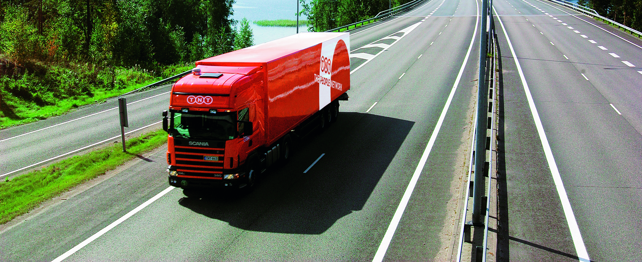
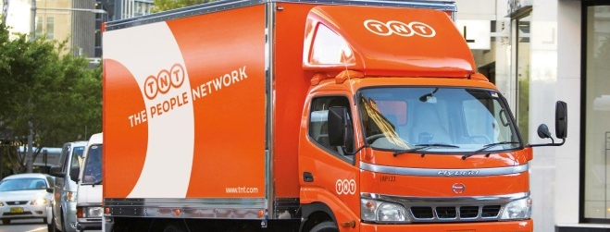
EMPOWERED BY THE WIDEST RANGE OF DELIVERY OPTIONS
We offer a unique range of services and delivery options via one contact compared to any other integrator or freight forwarder:
With TNT you can always combine dedicated first or last mile delivery with network transportation
We are the only integrator to offer Direct Express to ensure top speed for your shipments
We are able to deliver to specific departments within hospitals and to the named recipient
In addition, we are the only integrator to offer specific customer delivery options for express deliveries by road e.g. timed deliveries, non-ground floor deliveries.

Slide 6
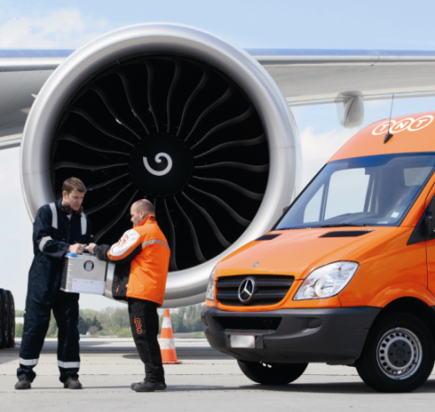
COMPLEMENTED BY BEST IN CLASS, INDUSTRY SPECIALIST DESKS
OVER 25 YEARS WORTH OF EXPERIENCE SERVING THE HEALTHCARE SECTOR AT YOUR DISPOSAL
Local, dedicated customer service teams have better local knowledge and planning capabilities
These teams are empowered to perform service recovery
No internal divisions, we offer multiple modes of transport and the widest range of services via one contact
Lower threshold for customers to get support of industry specialist desk

Slide 7
THANK YOU

